Slide 1
Project
Autonomous Car

Slide 2
Mahmoud Abdelsalam
mahmoudelsheikh20012001@gmail.com
Students Name
Mark Raafat
Mark.raafat55@gmail.com
Mohamed Elshafei Ali
mohamedelshafei292@gmail.com

Slide 3
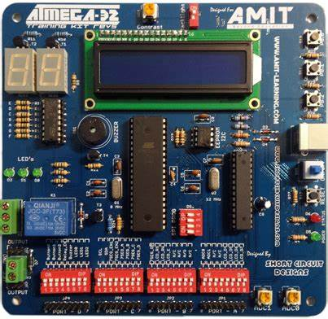
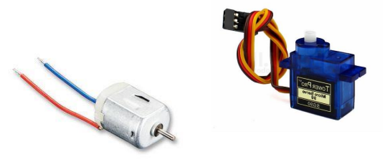
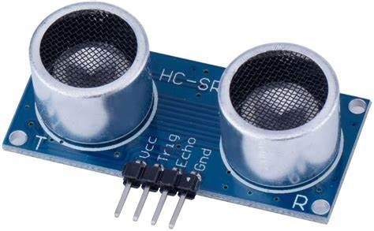
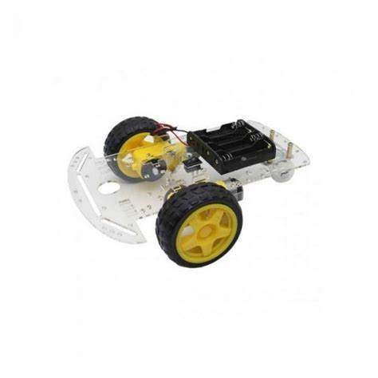
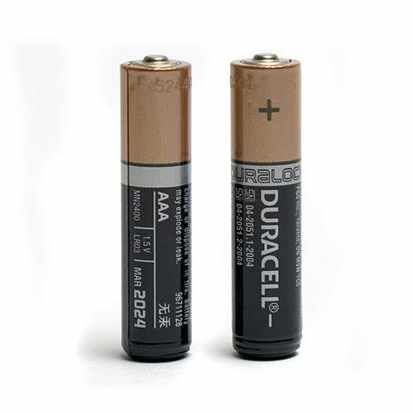
Project Components

Slide 4
Project Components
Ultrasonic HC- SR04.
Servo motor.
L293D.
Motors.
Caster wheel.
Chassis

Slide 5
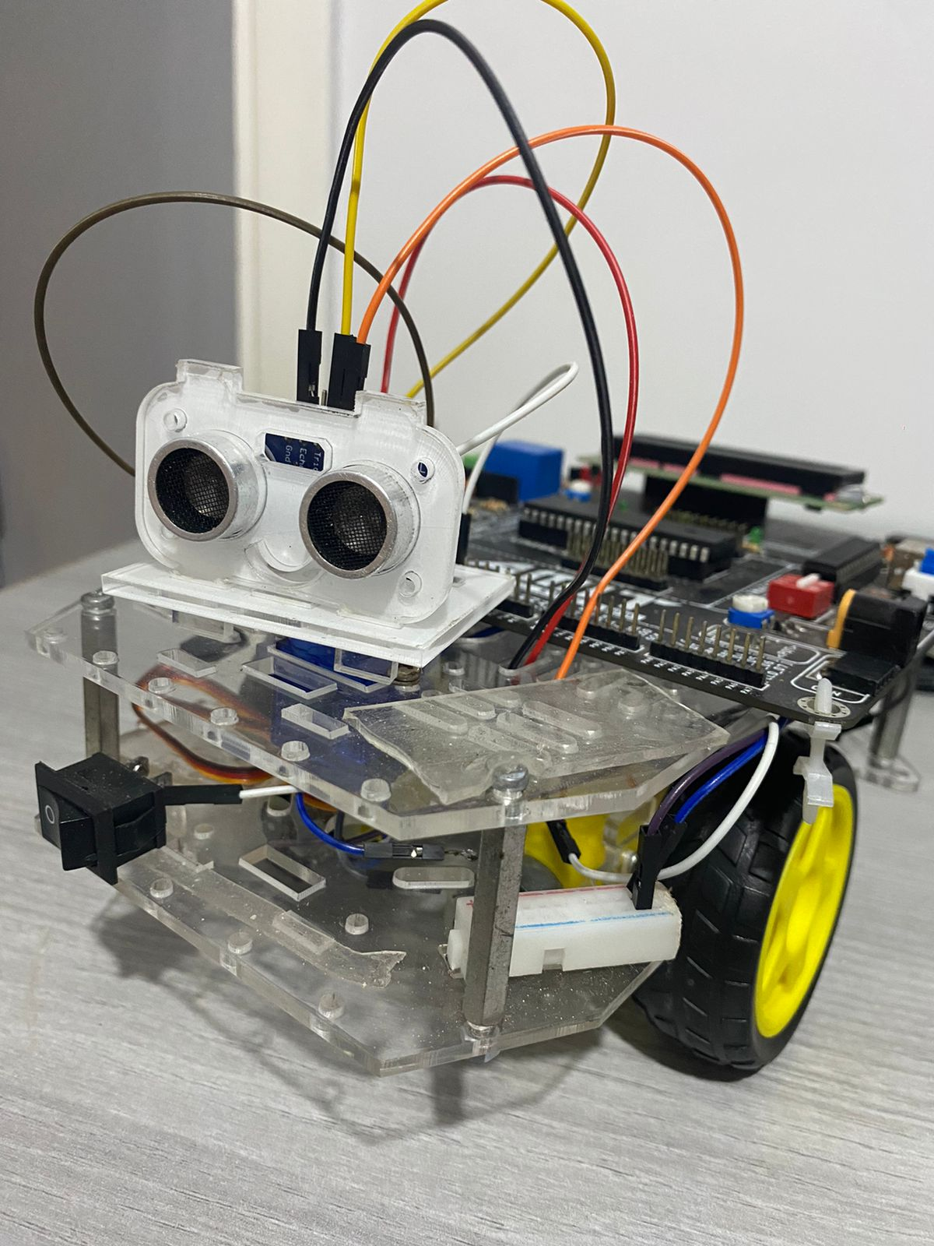
Welcome
For
Autonomous Car

Slide 6
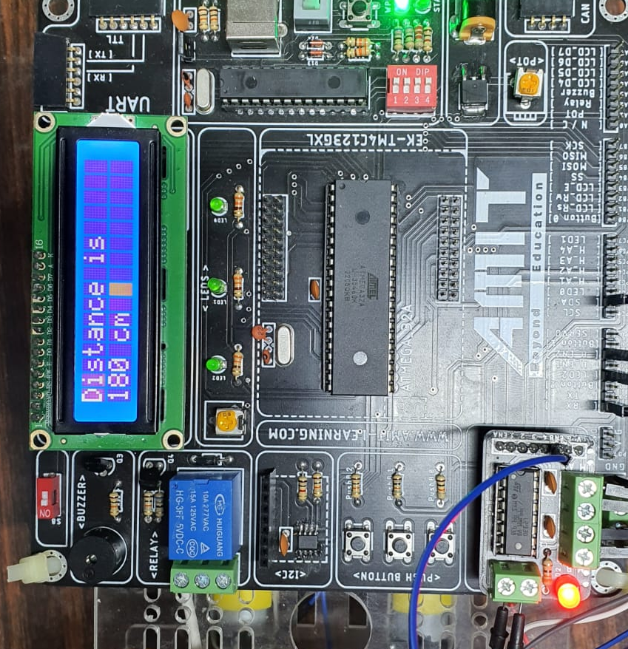
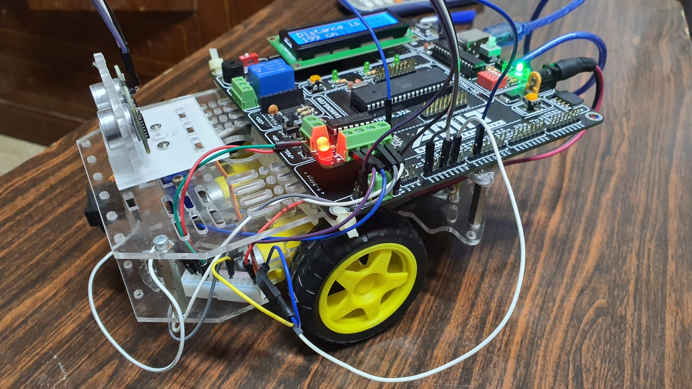


Slide 7
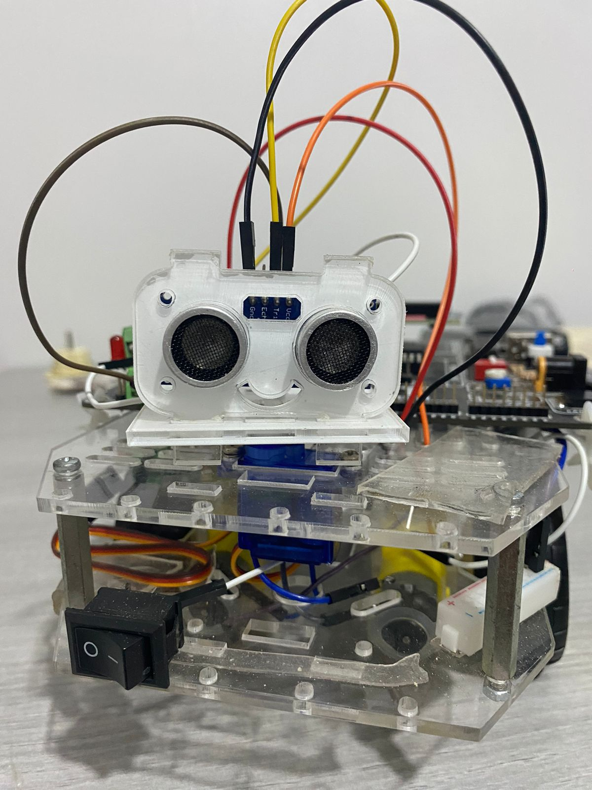
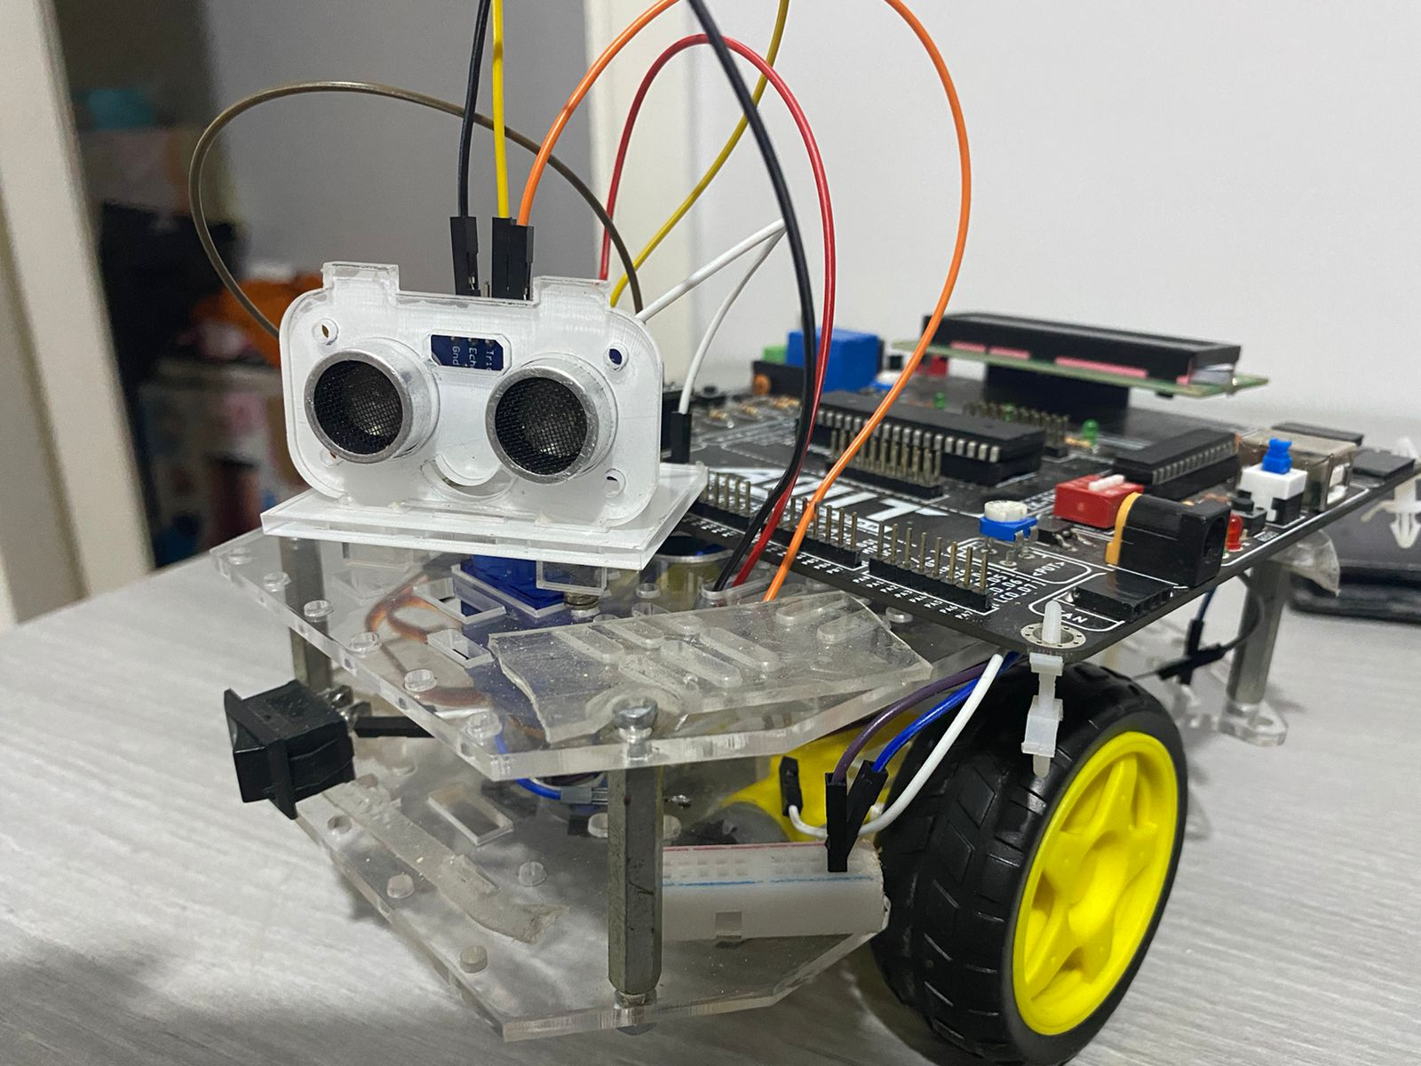

Slide 8
How Does The Robot work ?
The robot measures the forward distance.
When the distance is ideal robot moves forward.
The minimum distance from the wall is reached the vehicle stops.
Robot will now search for a better destination.
Looks right first then measures the distance if it is ideal the right motor is braked to pivot around and the left motor is on so Robot turns right.
If the right is not ideal it looks to the left and if it is ideal the left motor brakes to pivot on and the right motor is on so Robot turns left.
If both direction are blocked Robot reverses and rechecks the directions.

Slide 9
start
9
Dist>30cm
yes
forward
No
stop
Look right
yes
Turn right
Dist >15
No
Look left
yes
Dist>15cm
No
Turn Left
Reverse

Slide 10
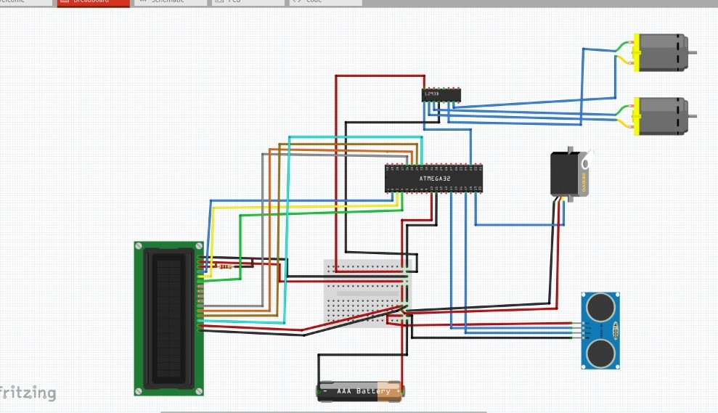




I want you to have a great and successful year!
You may visit with me about questions or concerns any time we are not in the middle of direct instruction, or I am not helping other students.
Project circuits
You may email me if necessary, and I will respond when I am able.
I am available for extra help before or after school. When possible, please let me know in advance so I can plan accordingly.

Slide 11
https://github.com/MarkRaafat/Oct-18---Autonomous-car.git
GitHub Link

Slide 12
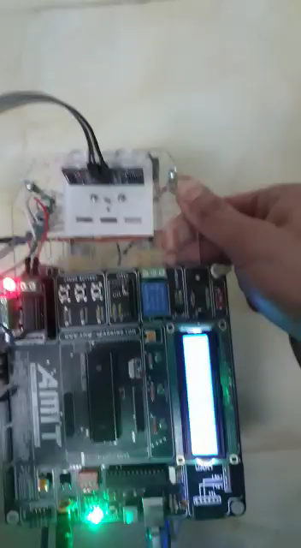
Thank You

